Slide 1
QMST 5335
More Simio Data Tables and Basic Animation

Slide 2
Learning Objectives
Using basic Data tables in Simio (SS Chapter 7)
Applying basic Animation tools in Simio (SS Chapter 4.8)

Slide 3
Outline
More Tables in Simio
Basic Animation

Slide 4
Outline
More Tables in Simio
Basic Animation

Slide 5
Sequence Tables
Entities and vehicles frequently need to follow a particular path:
  Registration – Triage – Exam – Treatment
  Downtown – Midtown – Uptown (repeat)
Path may vary by entity/vehicle
  Patient severity
  Vehicle zone, or local/express
Need a data table with a destination column for specifying the routing destination.
  Used when routing from a node is “By Sequence”.

Slide 6
Sequence Tables
A Sequence Table is a special type of data table used to specify a sequence of destinations for an entity.
  Add Sequence Table button will create a table and automatically add a column named Sequence for specifying a routing sequence for an entity.
  Each simple sequence table defines one routing plan (e.g., a list of node visitations).
  Each row in the sequence table corresponds to a specific location.
  Other data in row is usually used for location-specific properties, for example the processing time, priority, or other properties required at a particular location.
Let’s solve an example!

Slide 7
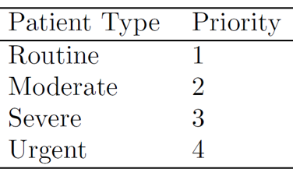
Sequence Tables
An Emergency Department – Revisited:
  Recall that there are 4 patient types:
    Patient Mix: Routine 40%, Moderate 31%, Severe 24%, Urgent 5%
    Arrival rate of patients: 15/hour → Random.Exponential(4)
  Five servers (ED areas) each with specified capacity
    Sign In (1), Registration (3), Exam Rooms (6), Treatment Rooms (6), Trauma Rooms (2)
    Service time at each server station will be different depending on the patient type
  Each patient type follows a specific sequence of treatments (e.g. room visitations)
    Routine: Sign In → Registration → Exam Room → Normal Exit
    Moderate: Sign In → Registration → Exam Room → Treatment Room → Normal Exit
    Severe: Sign In → Registration → Exam Room → Treatment Room → Normal Exit
    Urgent: Sign In → Trauma Room → Treatment Room → Trauma Exit
  Respect patient priority in treatment

Slide 8
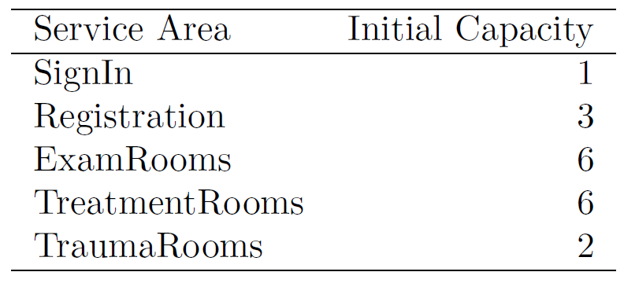
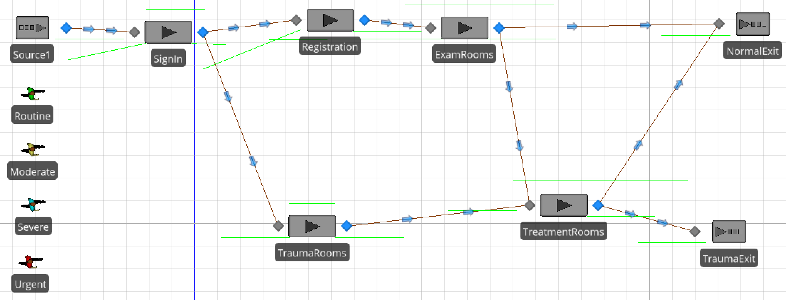
Sequence Tables
An Emergency Department – Revisited:
  First, create the model
    5 server objects (each has different capacity)
    2 sinks
    1 source
      4 entities!!
See ‘Emergency Department - Revisited.spfx’.

Slide 9
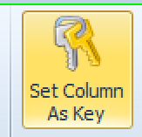
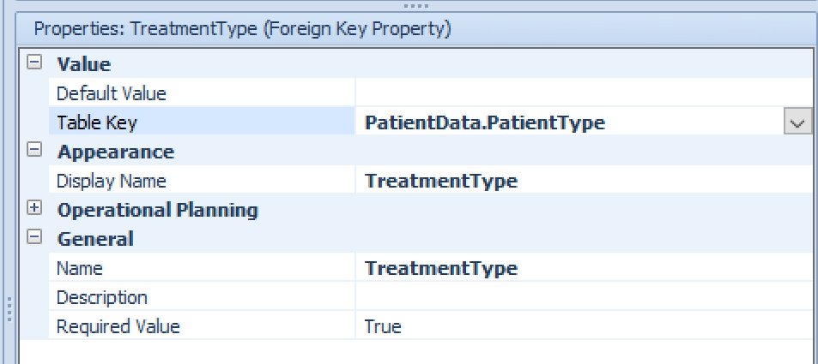
Sequence Tables
An Emergency Department – Revisited:
  We have a data table, PatientData, already
    Make PatientType column as the Key Column
      We will reference to PatientType column
    Also, remove TreatmentTime column
      Treatment times will depend on location and patient type!
  Add Sequence Table, name it Treatments
    There will be one column Sequence already by default
    Add ‘Foreign Key Property’, name it TreatmentType
      Since it is Foreign Key, it gets its values from somewhere else
    Finally, add a standard property →Expression, name Service Time

Slide 10
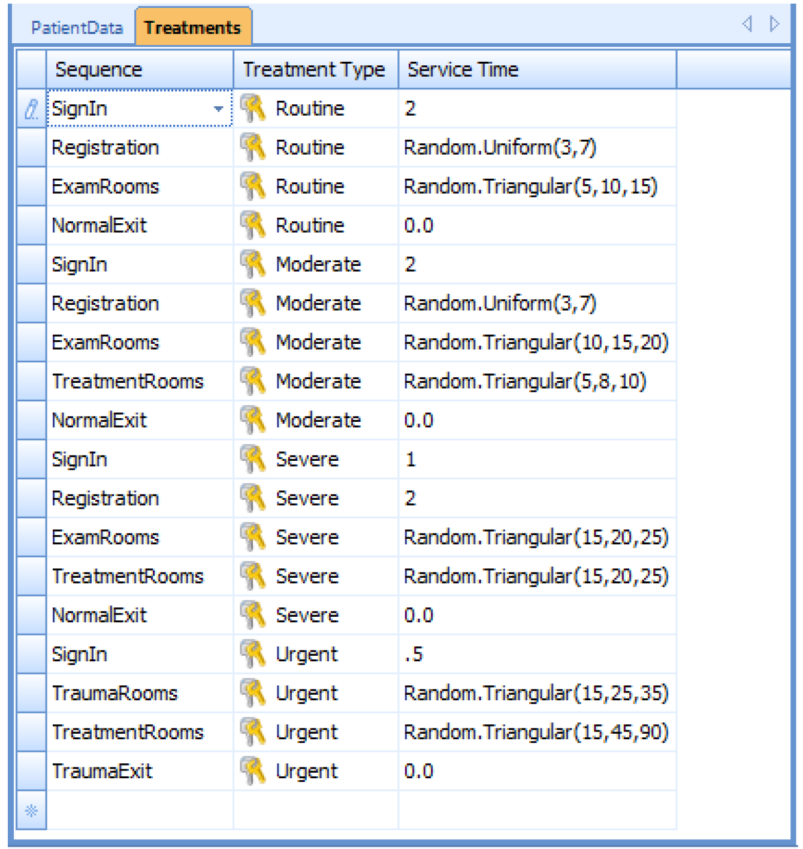
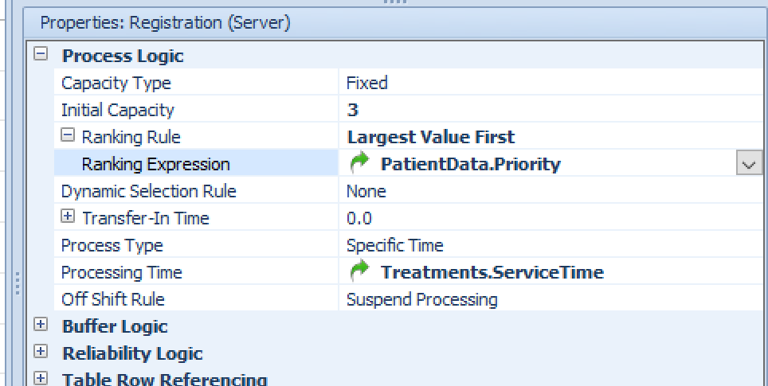
Sequence Tables
An Emergency Department – Revisited:
  Sequence column
    It lists the nodes, but all nodes
    Simplify, Accepts Any Node → False
    Then fill out the table!!
  Refer to the tables in the Facility
    Registration server:

Slide 11
More Data, More Tables
Rate Tables
  If arrivals are independent and random, they follow a Poisson process.
    The number of arrivals in a fixed time is Poisson.
    The time between arrivals is exponential.
  In some cases the arrival rate may vary over time – Simio supports step-wise linear arrival rates using a Rate Table.
  Read SS Chapter 7.3!
Lookup Tables
  Sometimes, a value depends on other values!
    Sometimes, can be done with expressions
  Read SS Chapter 7.4!
And more…
  Lists and Changeovers, see SS Chapter 7.5
  State Arrays, see SS Chapter 7.6

Slide 12
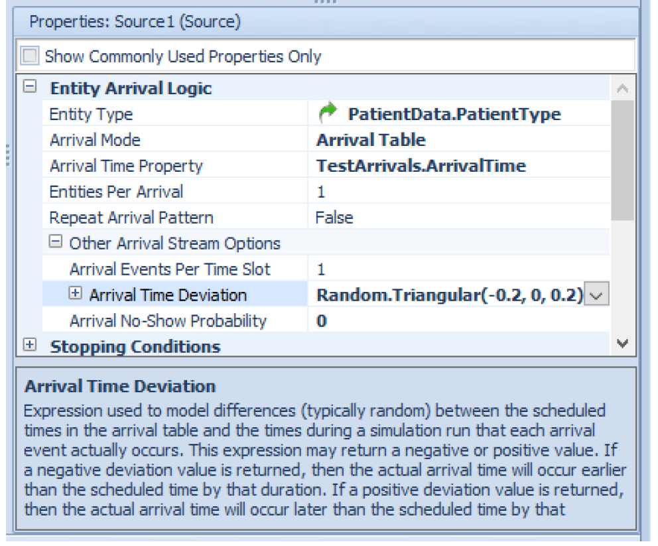
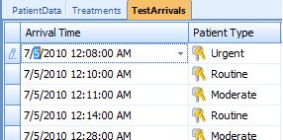
Arrival Tables
A table containing specific arrivals.
  Used to generate entities with specific known arrival times.
  Can represent individual entities or batches.
  Deterministic mode useful for model validation and scheduling applications.
  Stochastic mode useful for scheduled arrivals like a doctor’s office.
Read SS Chapter 7.1.5
SimBits:
  AppointmentArrivals,
  UsingRelationalTables

Slide 13
Schedules
Any object can be a resource and have a capacity that may possibly vary over time.
Many objects support following a Work Schedule that allows capacity to change automatically over time.
The numerical capacity is also used to determine if a resource is in the On-Shift state (capacity > 0) or Off-Shift state (capacity = 0).
  For some objects (Worker, Workstation) capacity can be only either 0 (off-shift) or 1 (on-shift).
  For most objects a schedule can represent a variable capacity (e.g., five for 8 hours, then four for 2 hours, then zero for 14 hours).

Slide 14
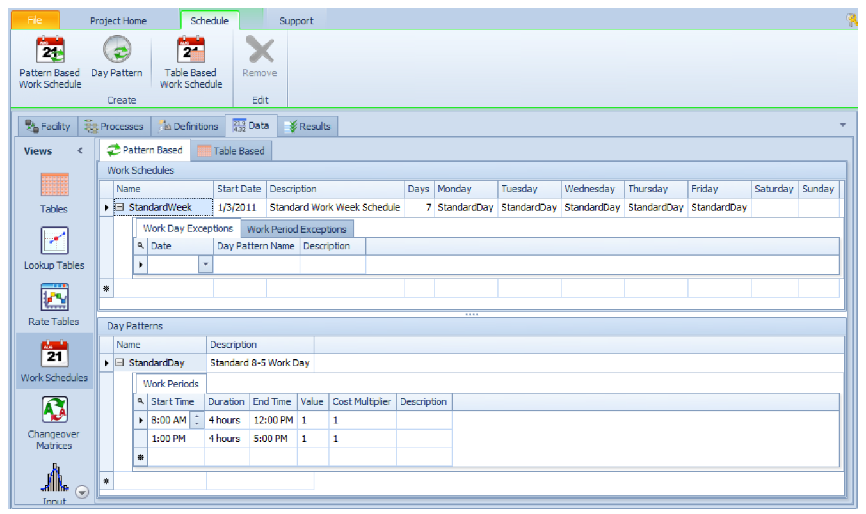
Schedules
Work Schedule is a repeating set of Day Patterns
  Read SS Chapter 7.2!

Slide 15
Outline
More Tables in Simio
Basic Animation

Slide 16
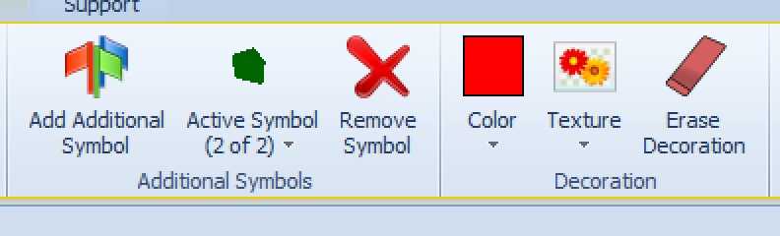
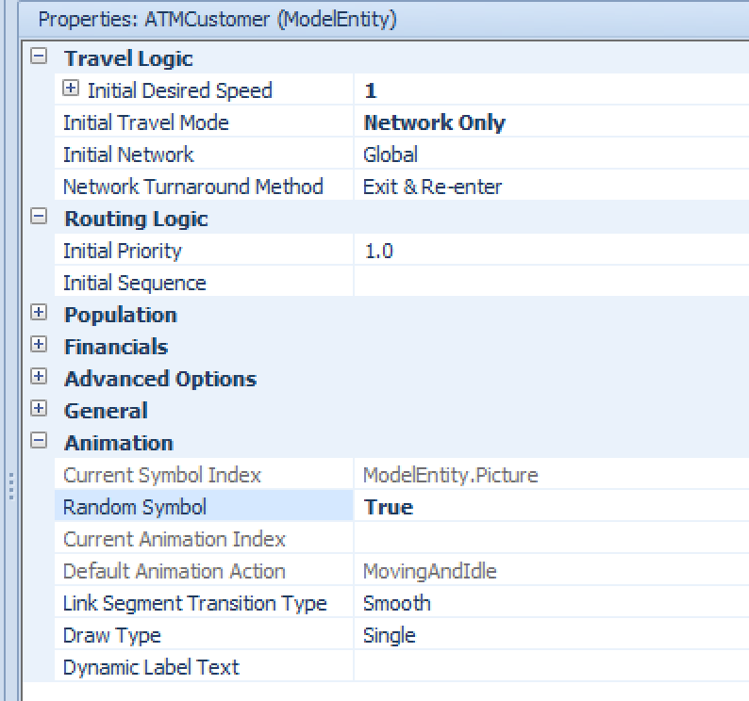
Basic Model Animation
We will review some basic animation tools
We will use the ATM Model
Symbols:
  By selecting an entity/object, Symbols become active
    You can add additional symbols for an entity with different colors
    By default, Simio uses the first one
  After adding additional symbol
    Change ‘Random Symbol’ to true
    Simio will randomly select from the active symbols
  Go to Model Entity (on the right)
    Definitions→States
      Picture
        Set Initial State Value to whichever symbol wanted (0? 1? 2?..)
        Make Random Symbol False to see the affect

Slide 17
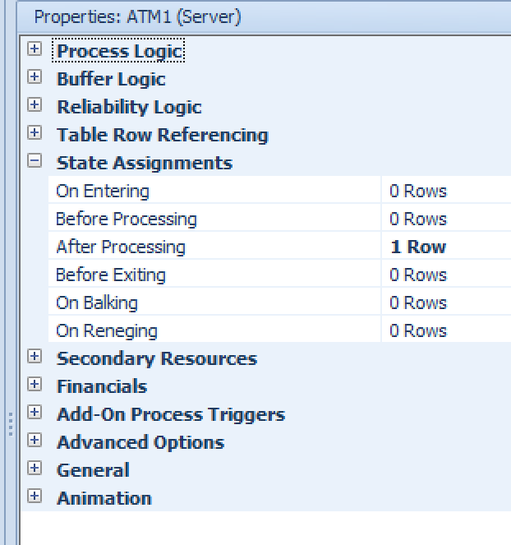
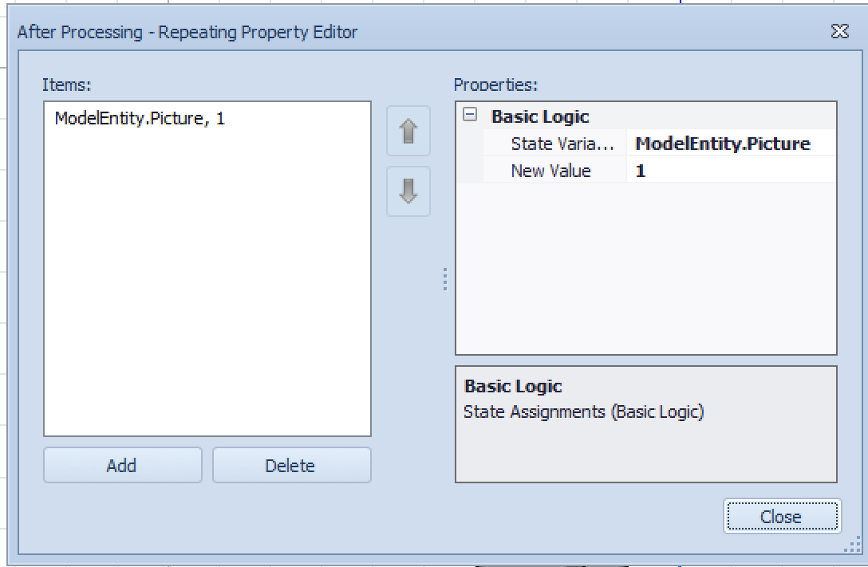
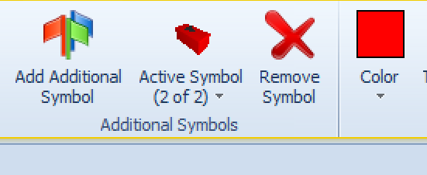
Basic Model Animation
Symbols:
  Let’s say we have two symbols (green and red) and initial value is 0 (green)!
  After a customer is done with ATM, the entity picture turns red. How to do that?
  When the server object is busy, it turns red?
    Just pick the server and change color for state 1 (Processing) symbol
    You can change the color when it is idle as well (the same way!)

Slide 18
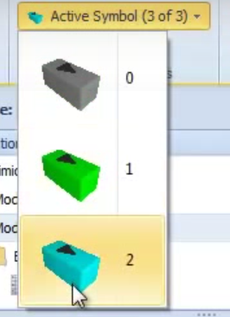
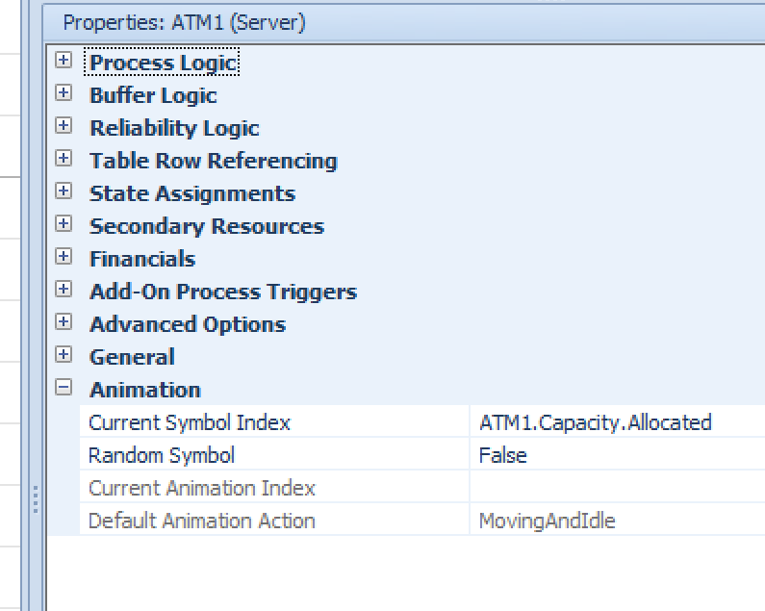
Basic Model Animation
Symbols:
  Suppose there are 2 ATM machines in the ATM station
    ATM server object: grey when both idle, green when 1 is idle, blue when none is idle!

Slide 19
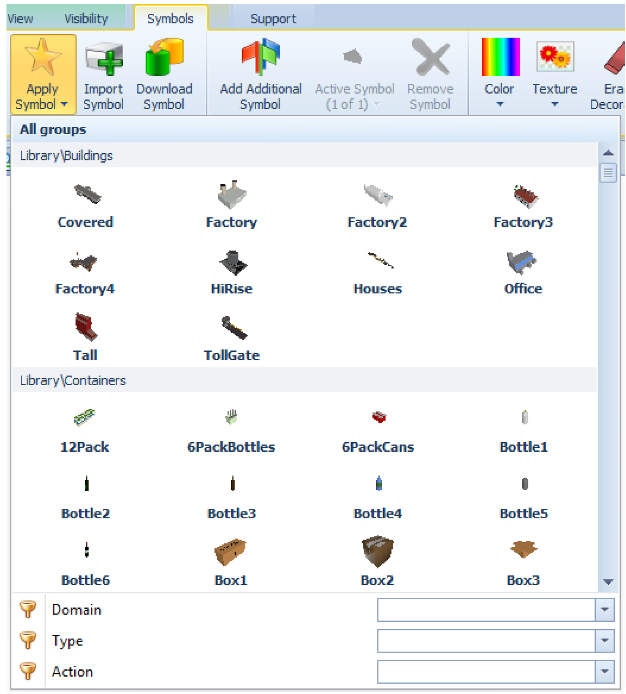
Basic Model Animation
Symbols:
  Other than triangles?
    >300 symbols
    27 categories
    Apply Symbol button
      You can use Domain, Type, Action for searching
  You can upload pictures, draw pictures!
  You can use them just as the other symbols

